Slide 1


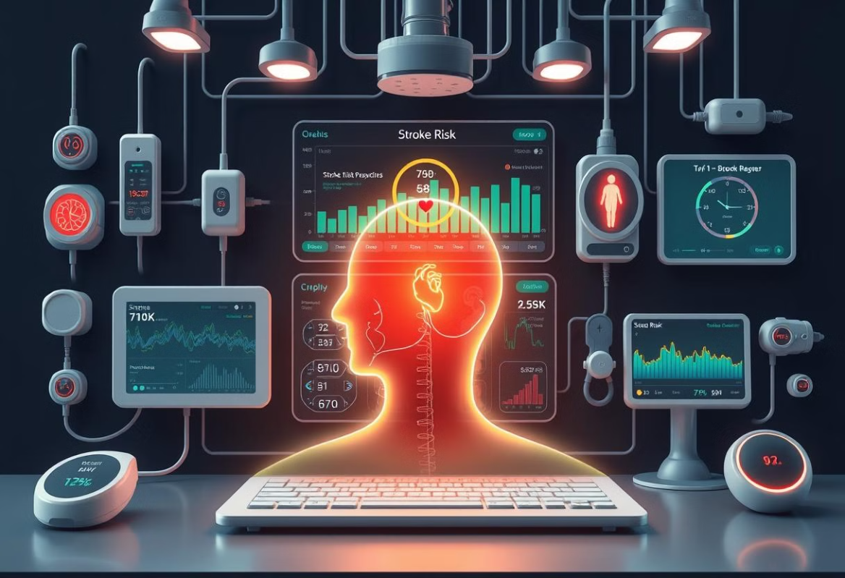
Predicting Cerebrovascular stroke disease related to Heart Disease.
Supervised by: Dr. Hussam Elbehiery
Co-Supervised by: Eng. Ahmed AbdelMoneim

Slide 2
Project’s Team
Name | Department
Ahmed Yasser EL Sharkawy | AI
Ibrahim Ehab Hassan | AI
Ahmed Mohamed Gad Al Mawla | AI
Ahmed Ali Ali Abd Elshafy | AI
Ahmed Amr Afte Deghedy | AI
Arwaa Mohamed Hassan | CS
Sohila Wessam Hamed Refaie | CS
Afnan Fekry Moahmoud Hammad | IS

Slide 3
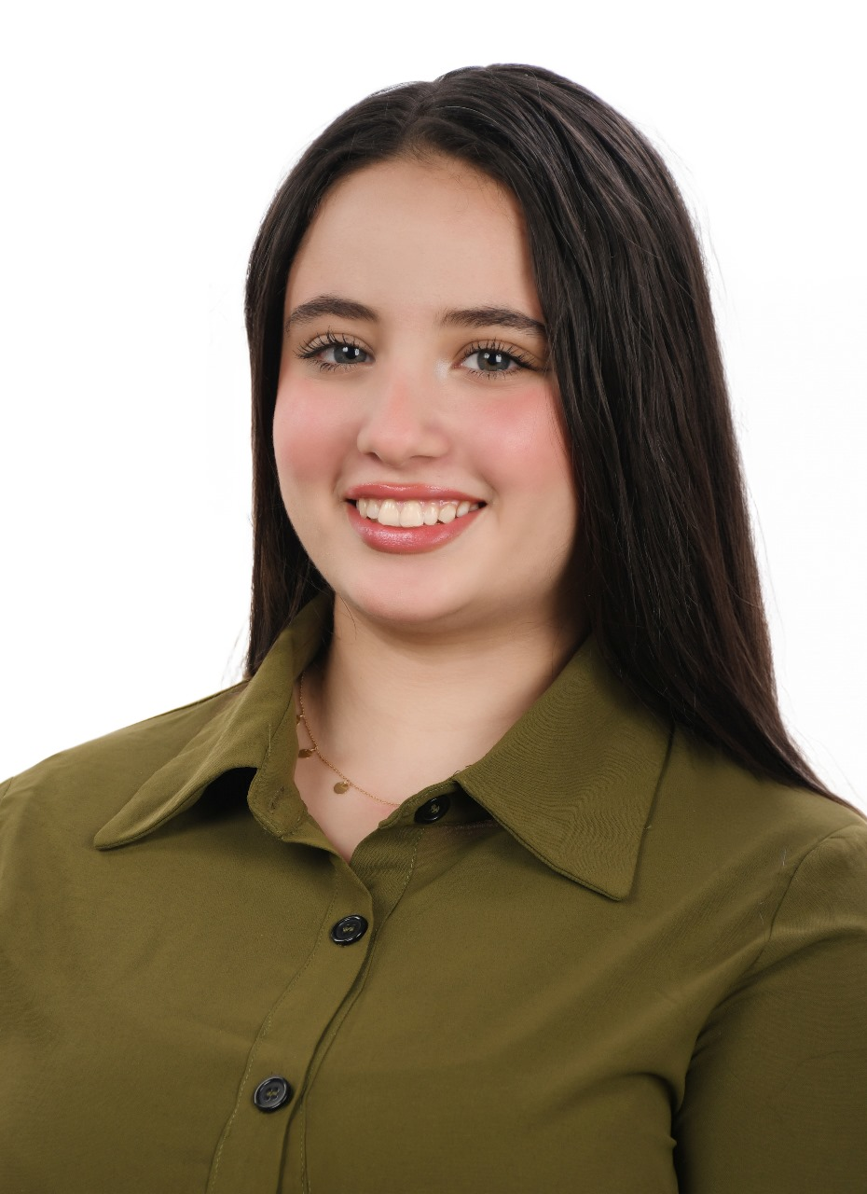


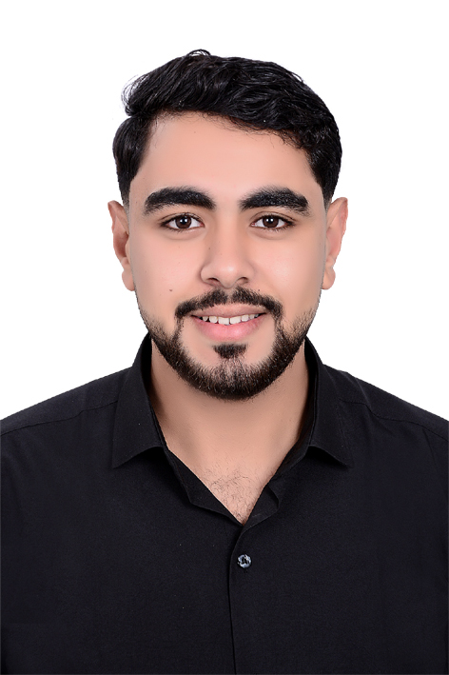
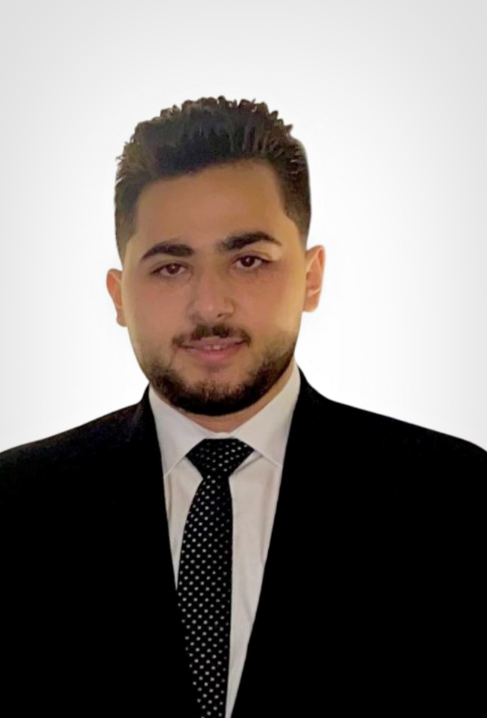
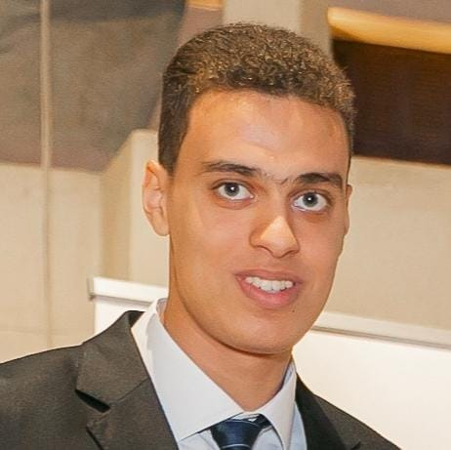


Our Team

Slide 4


01
Introduction
02
Hardware Components
Mobile Application
Agenda
03
04
AI Implementation
05
Future Work & Conclusion

Slide 5
01
Introduction
02
Hardware Components
02
Suggested Application
Application Designs & methodology
03
03
Mobile Application
Agenda
04
AI Implementation
04
Diagrams
05
05
Conclusion
Future Work & Conclusion

Slide 6
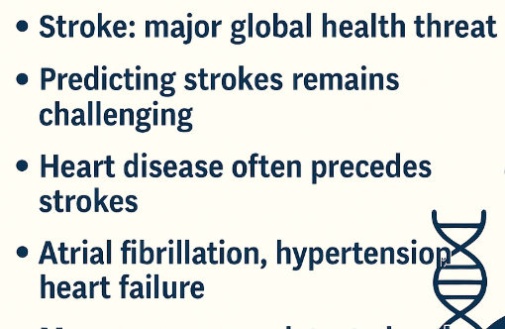
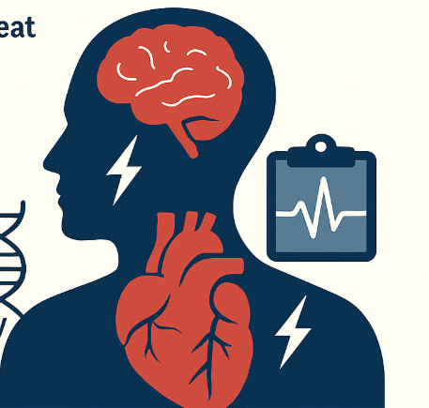
Introduction: Understanding Stroke and Its Connection to Heart Disease

Slide 7
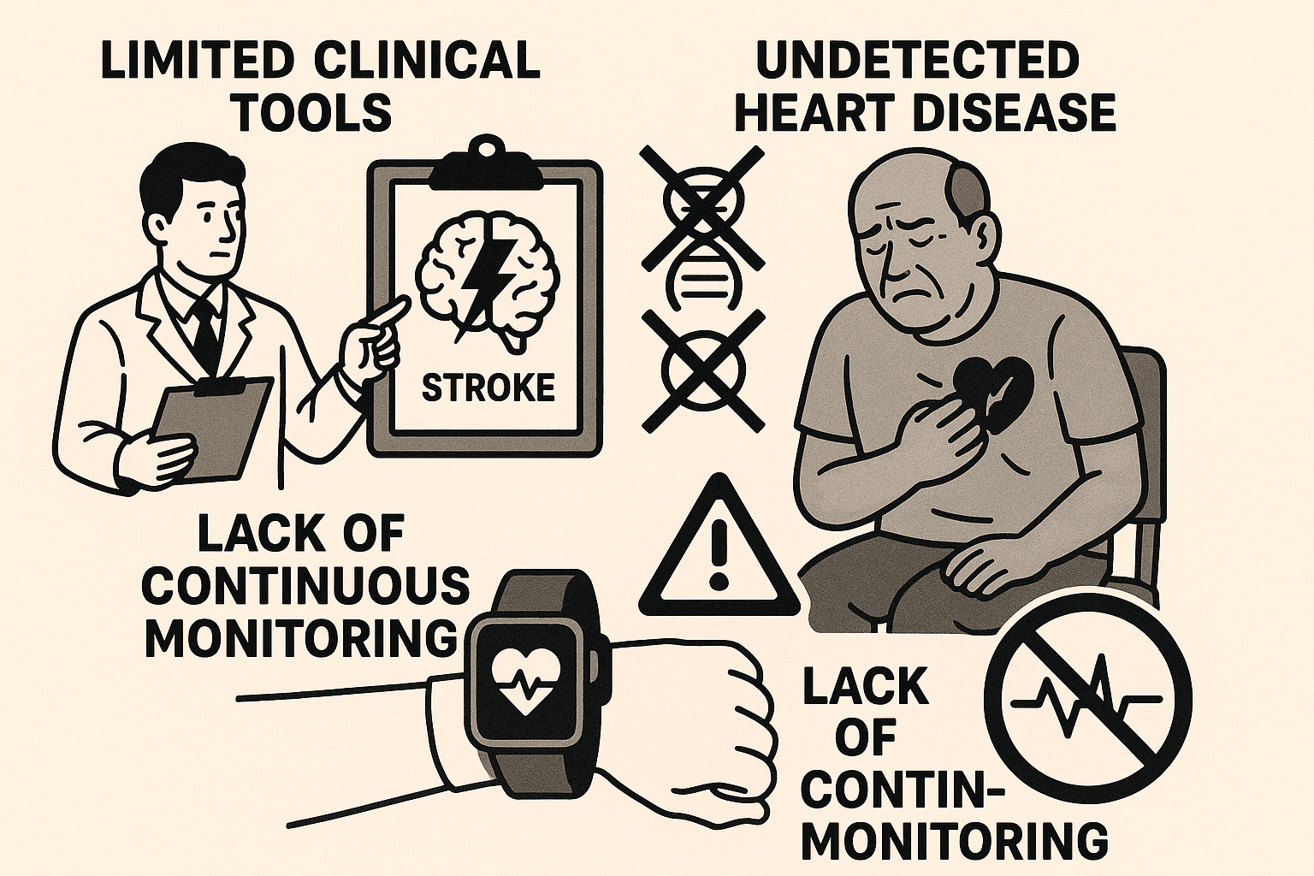
Problem Definition :

Slide 8

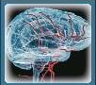


Stroke-Related Mobile Applications
Logo
Logo
Stroke Connect
Stroke Management
Logo
Stroke Awareness Foundation
Logo
Stroke Riskometer

Slide 9
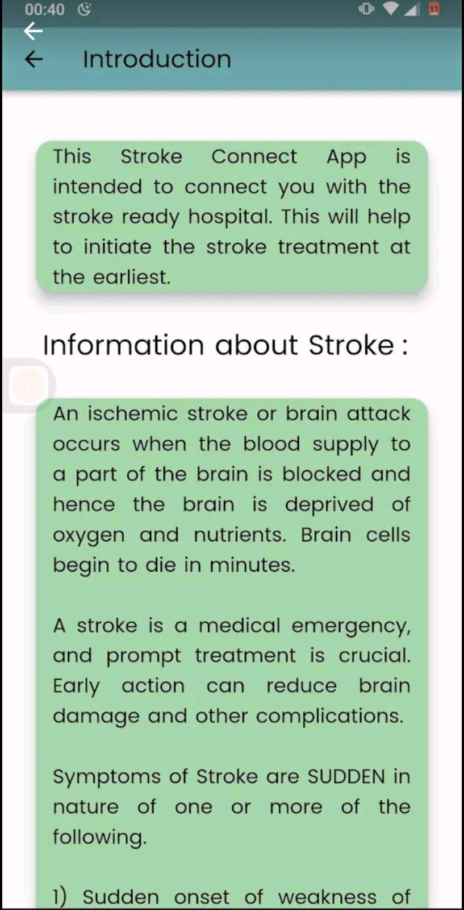
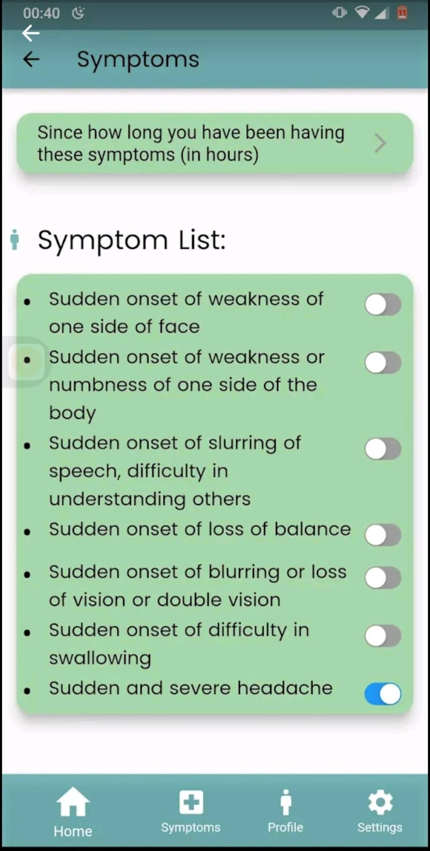
Stroke Connect
Pros:
Provides real-time location of stroke care hospitals.
Offers personalized stroke risk assessment and emergency info.
Cons:
Only available in select regions.
Requires stable internet for location-based services.

Slide 10
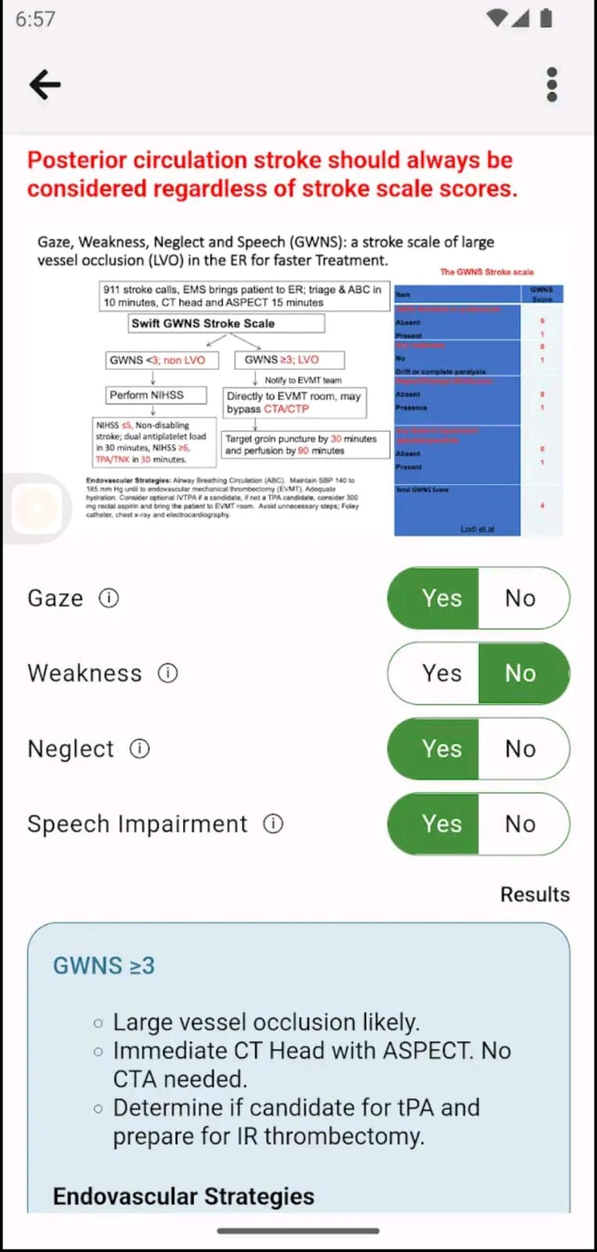
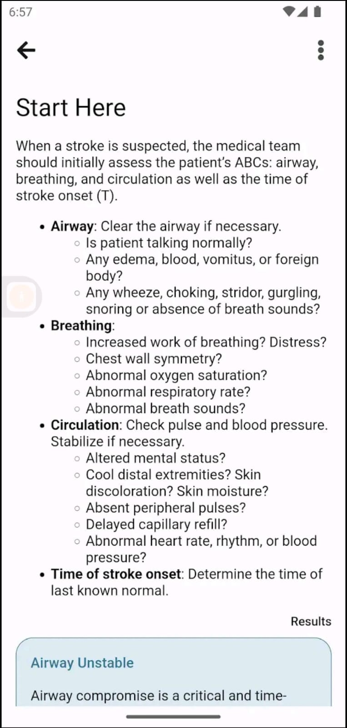
Stroke Management
Pros:
Helps track and manage stroke recovery progress.
Provides educational resources for stroke patients and caregivers.
Cons:
May require internet access for full functionality.
Limited customization for individual patient needs.

Slide 11
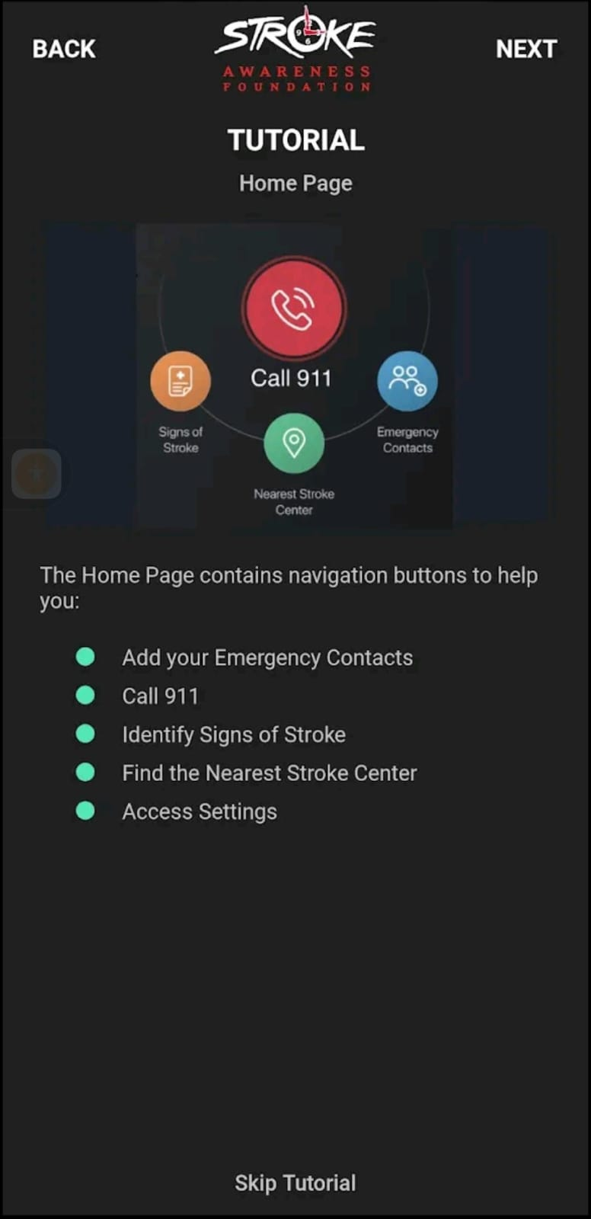
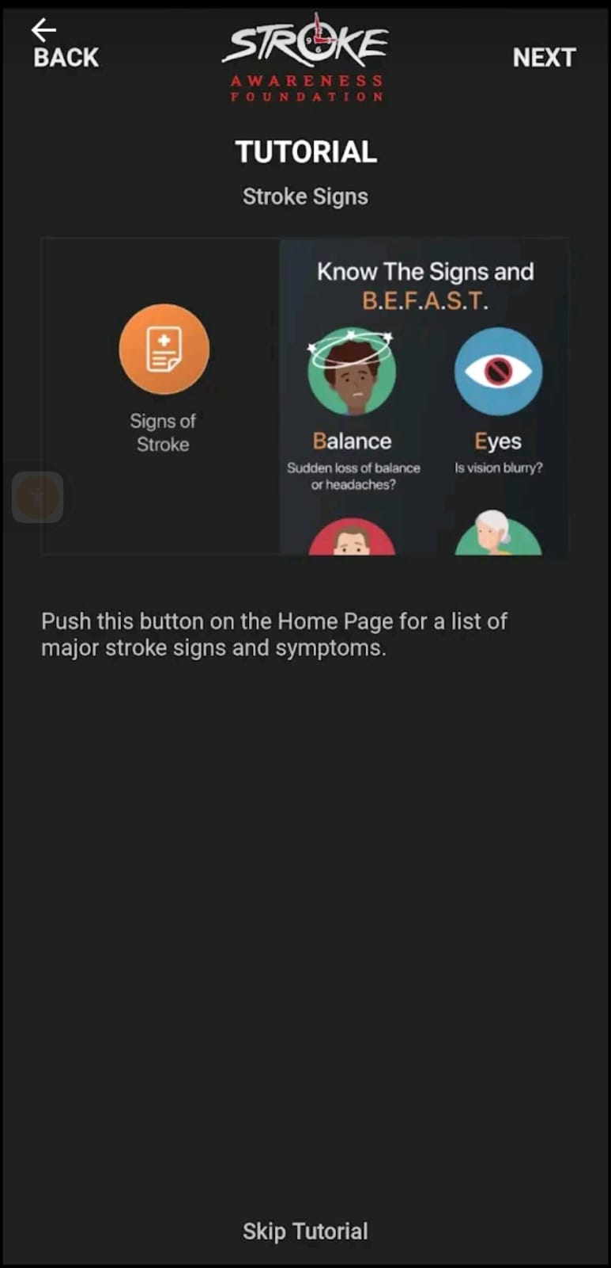
Stroke Awareness Foundation
Pros:
Raises public awareness about stroke symptoms.
Provides access to emergency response information.
Cons:
May have limited interactive features.
Content might not be regularly updated

Slide 12
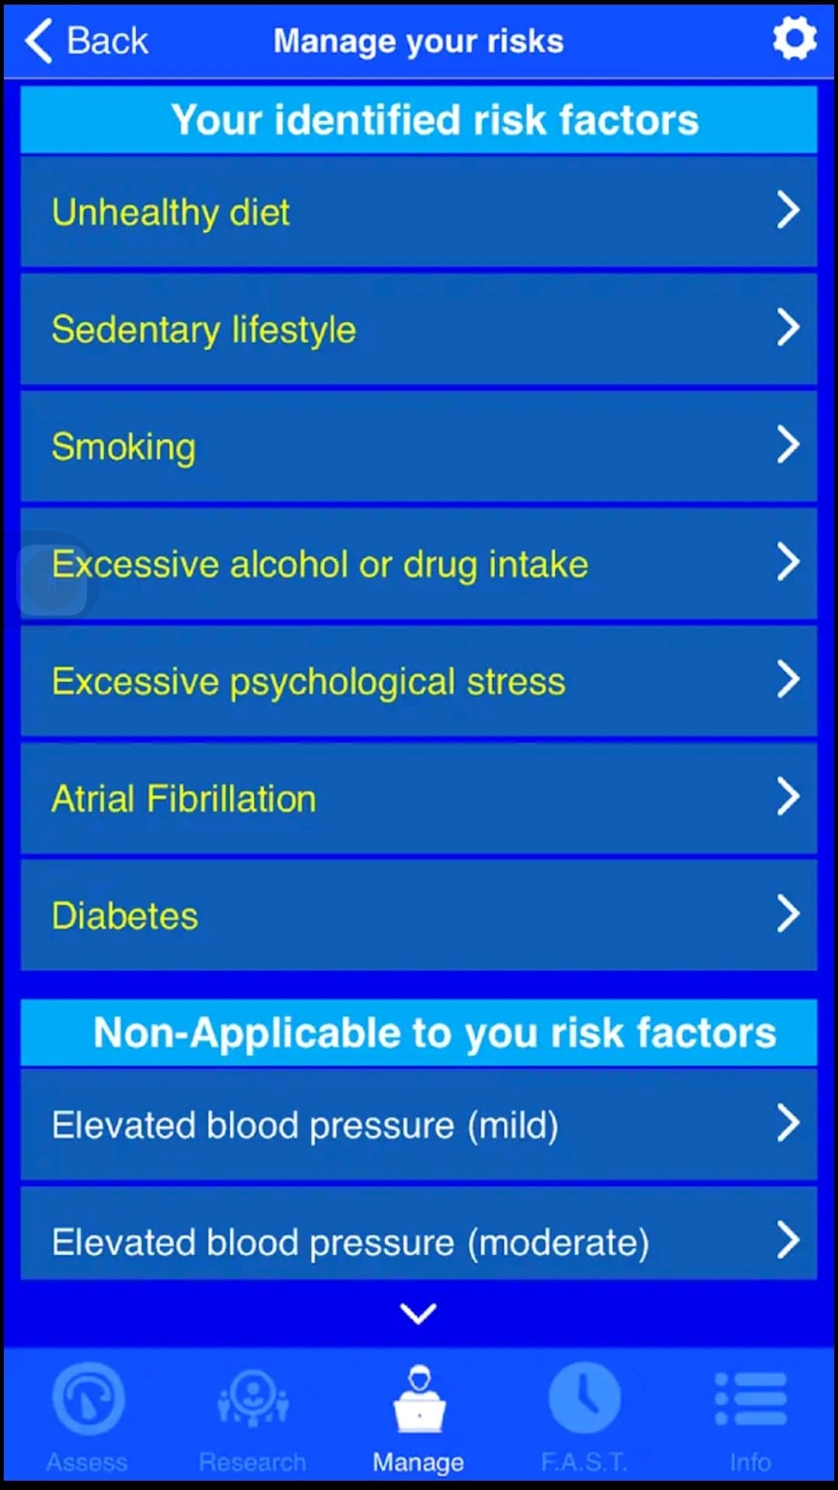
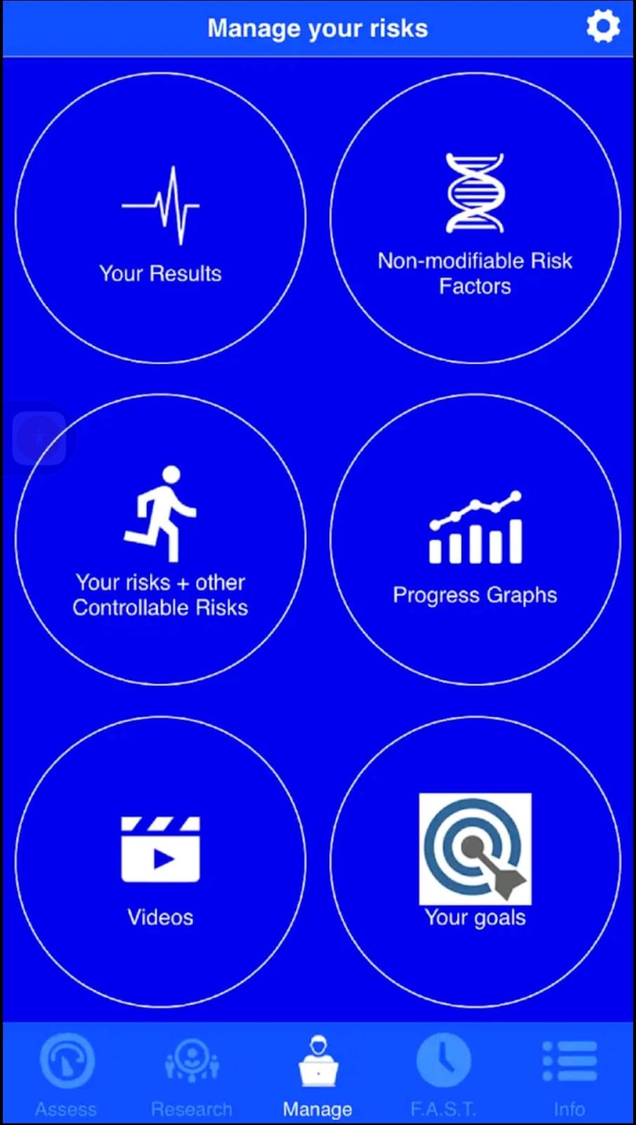
Stroke Riskometer
Pros:
Assesses individual stroke risk quickly.
Encourages preventive health measures.
Cons:
Risk predictions may not replace medical advice.
Limited accuracy if user inputs incorrect data.

Slide 13
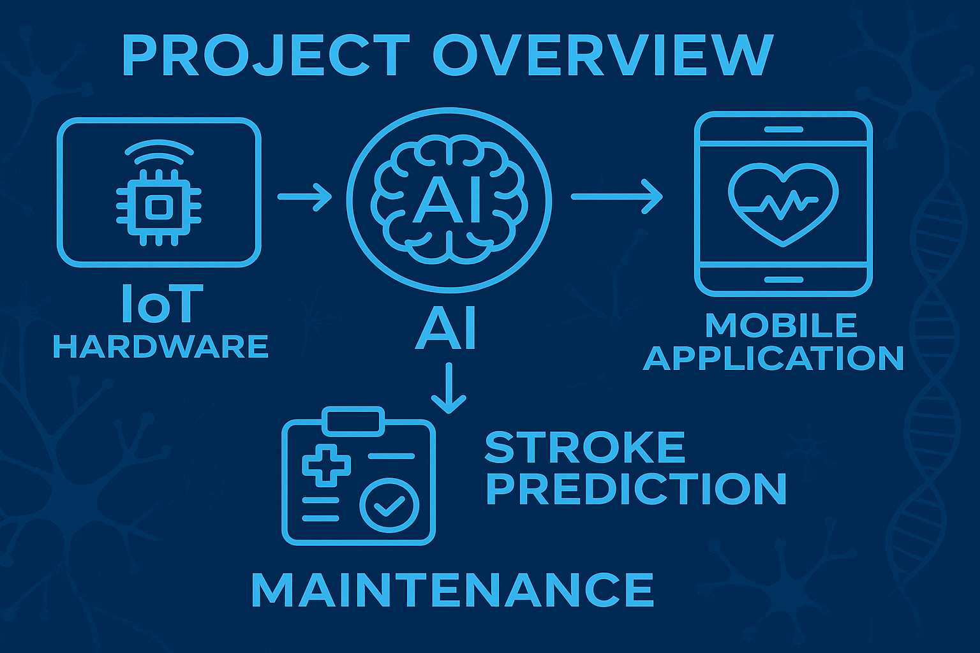
Our Proposed Solution: Sahha

Slide 14
Workflow: Step-by-Step Process
Sensors Capture Data
1
Heart rate, blood oxygen, and heart activity are measured and turned into digital signals.
2
Arduino Processes Data
The Arduino receives the data, cleans it up, does calculations, and prepares it for sending.
Data Transmission and Display
3
The data shows up on the screen and is sent wirelessly to your phone app.
4
Result Display
The app displays the analysis results from the AI model.
Data Storage
5
The app saves your data for later use.

Slide 15
01
01
Introduction and Workflow
Introduction
02
Hardware Components
02
Suggested Application
Application Designs & methodology
03
03
Mobile Application
Agenda
04
AI Implementation
04
Diagrams
05
05
Future Work & Conclusion
Conclusion

Slide 16
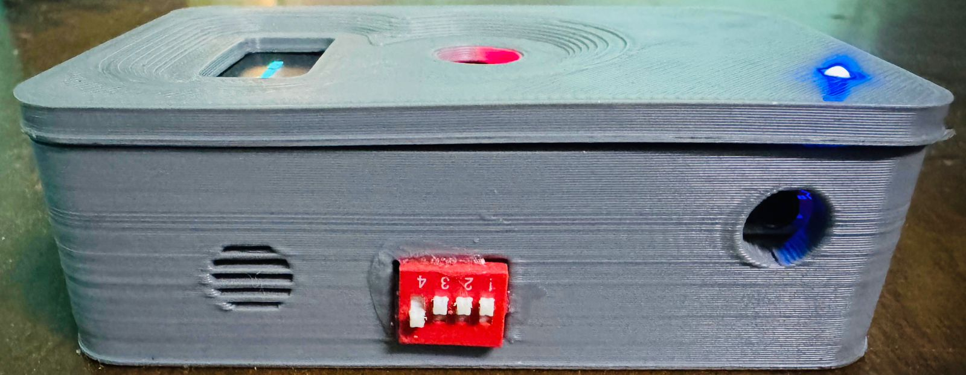
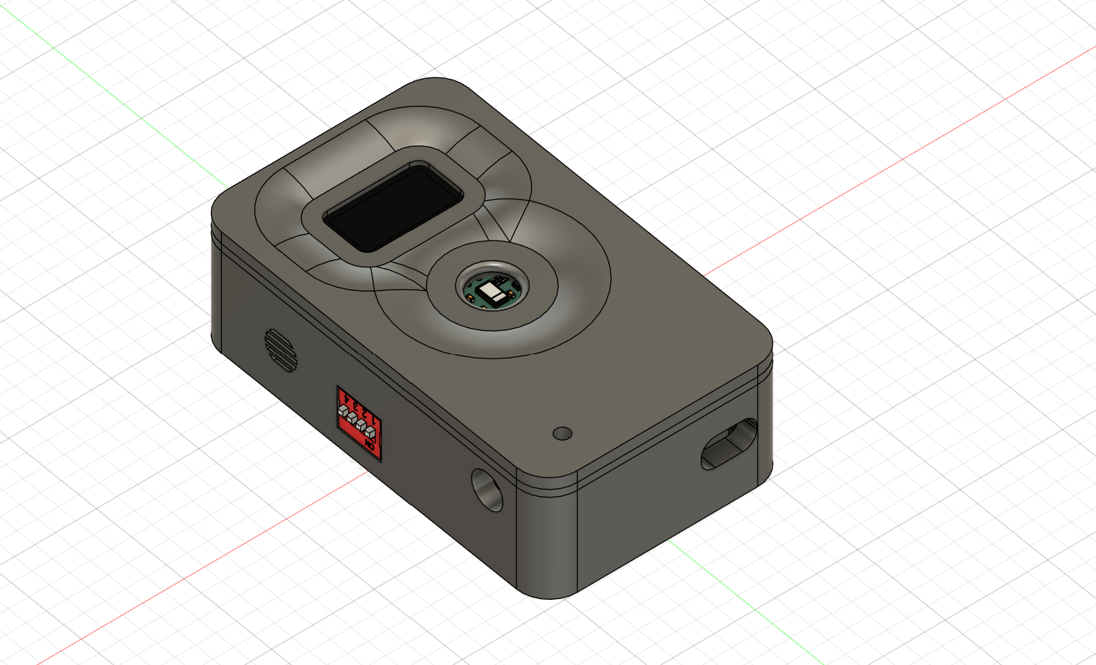
Hardware: Overview
A smart system using Arduino to monitor vital signs.
It provides early warnings for potential stroke risk.

Slide 17
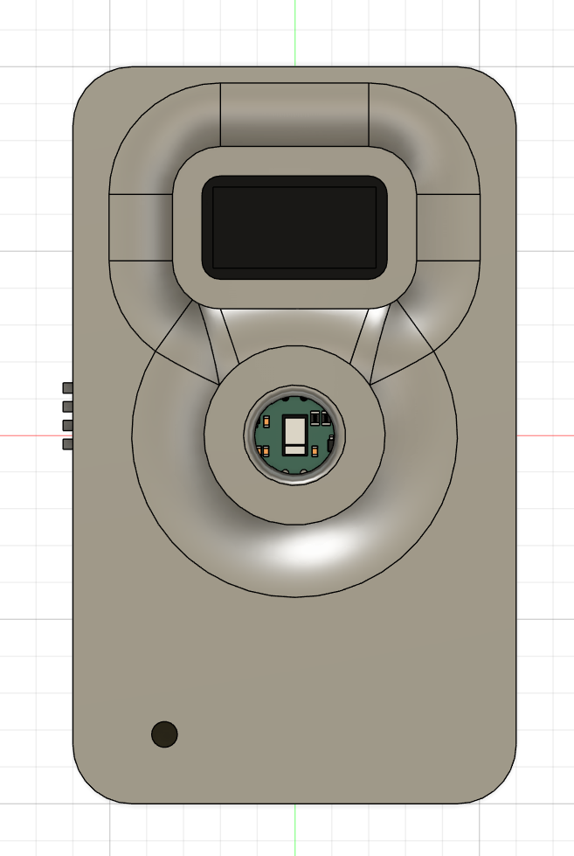
Hardware: Custom 3D Case
.
Custom casing made with 3D printing for durability.
Allows easy prototyping and component protection

Slide 18
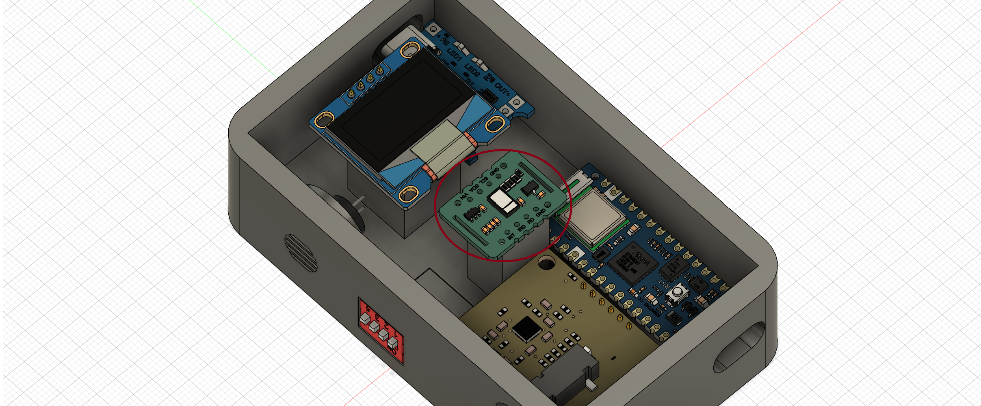
Hardware: MAX30102 Sensor
Measures heartbeats per minute, indicating heart health
Normal range is 60–100 BPM; irregular rates may signal risks.
.

Slide 19
Hardware: MAX30102 Sensor
Shows oxygen saturation in blood, normally 95–100%.
Low levels may indicate health problems or stroke risk.

Slide 20
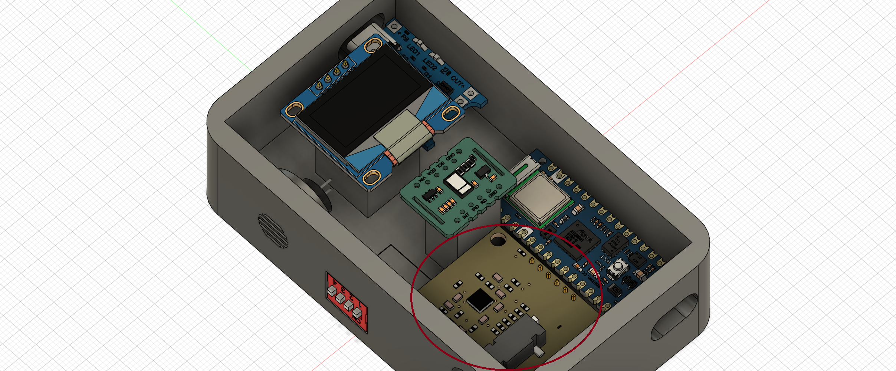
Hardware: ECG Sensor
Records the heart’s electrical activity to detect irregularities.
Certain patterns can signal stroke risk or heart issues..

Slide 21
Hardware: Wireless Monitoring<<BLE>>
Sends real-time health data wirelessly to mobile devices.
Enables apps to monitor :
BPM live
SpO2 live
ECG live

Slide 22
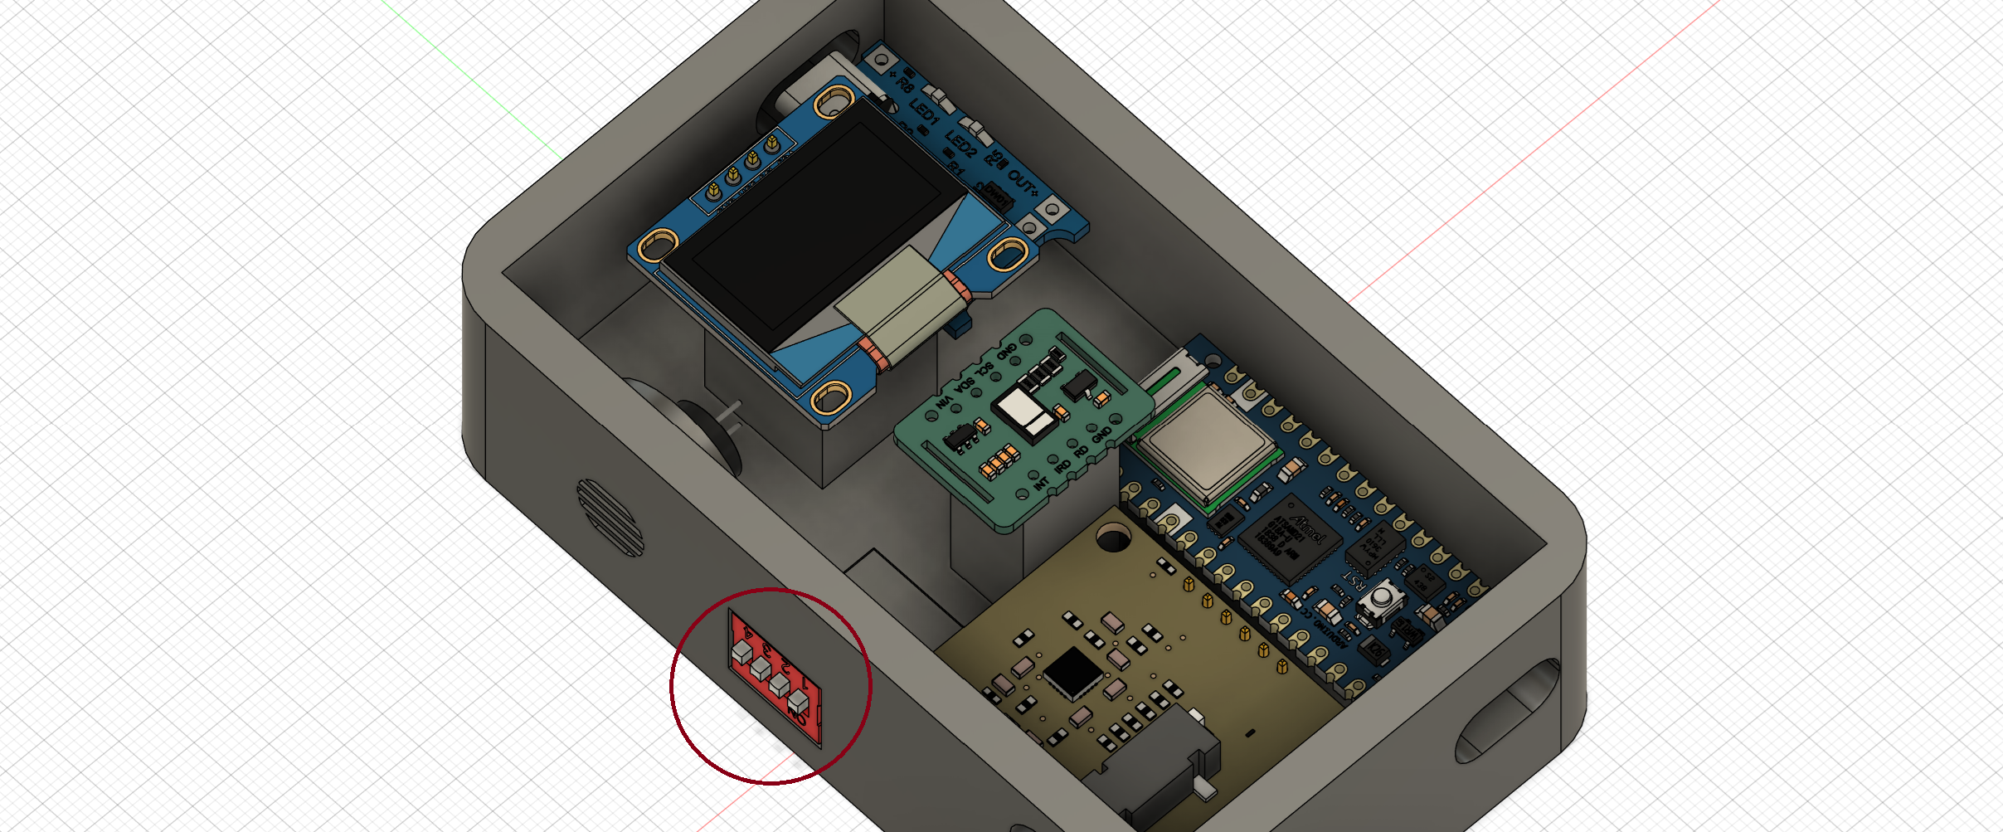
Hardware: Control Buttons
Four buttons control the device’s functions and power.
Each button activates a specific sensor or powers the device.

Slide 23
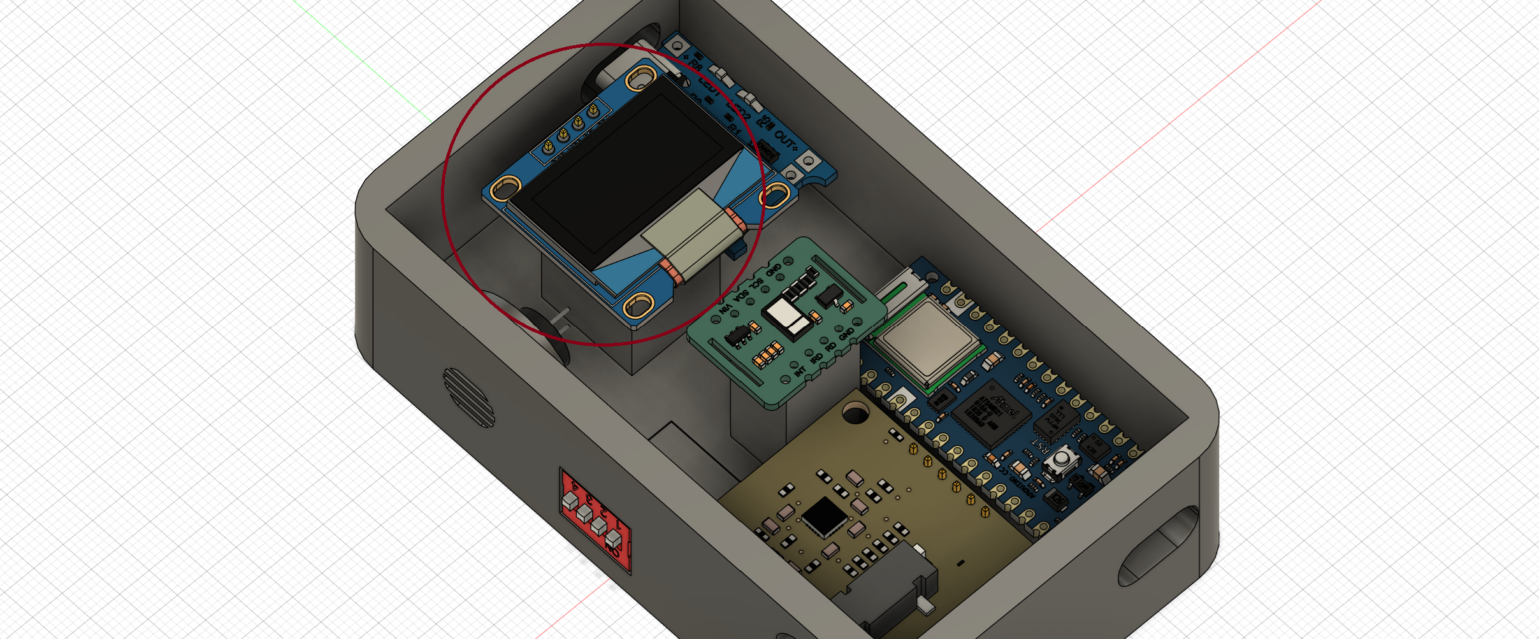
Hardware: OLED screen
Sensor data shown clearly on OLED screen
Buzzer beeps with each heartbeat for real-time alerts

Slide 24
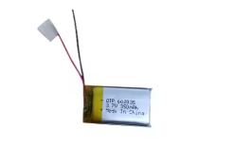
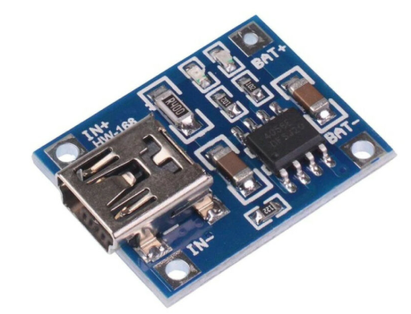
Hardware: Power Supply
Powered by a 350mAh rechargeable lithium battery.
Provides portability and long monitoring time.

Slide 25
01
01
Introduction
Introduction and Workflow
02
Hardware Components
02
02
Hardware Components
Suggested Application
Mobile Application
Agenda
03
04
AI Implementation
05
Future Work & Conclusion

Slide 26
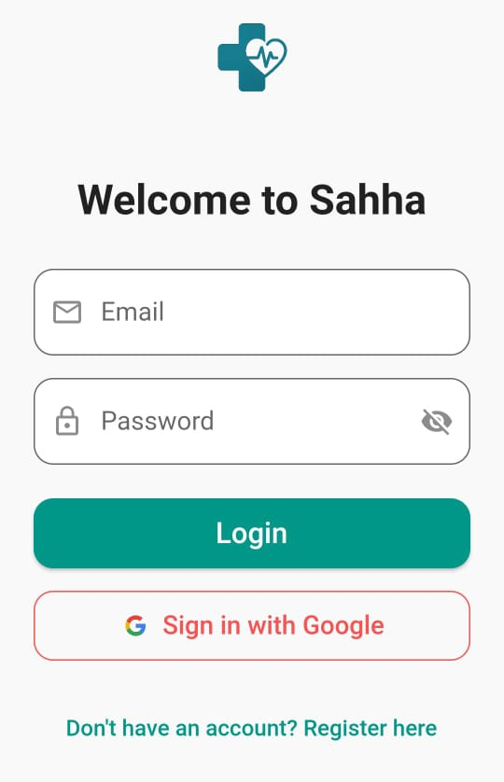
Login & Authentication:
Users can log in using email/password or with Google.
This helps the user log in easily and safely.

Slide 27
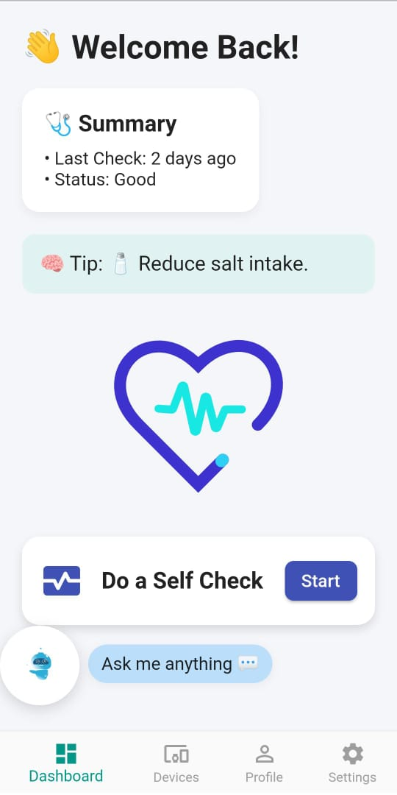
Dashboard:
After login, the user sees this screen.
It shows the last health check and a health tip.
The user can press the button to do a new check.

Slide 28
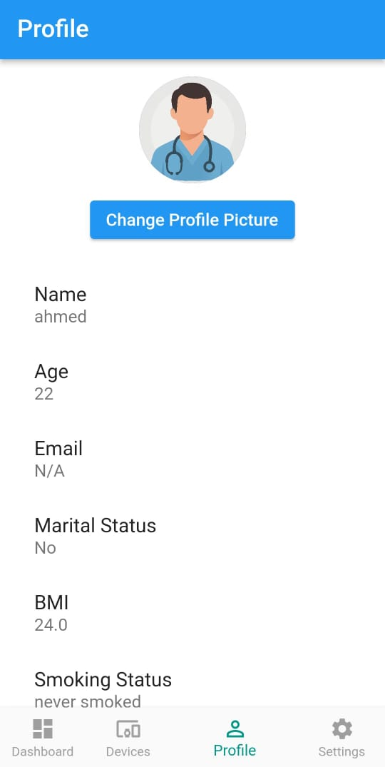
Profile:
The profile shows the user’s info Like: name, age, BMI, and if they smoke
This info is used in the health check.

Slide 29
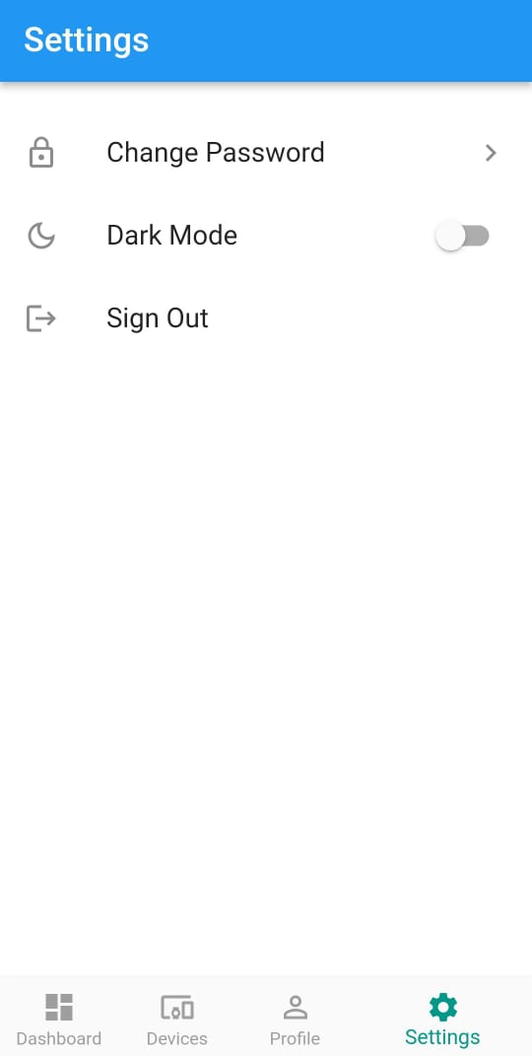
Settings:
The user can change password, turn on dark mode, or sign out.
It’s simple and useful.

Slide 30
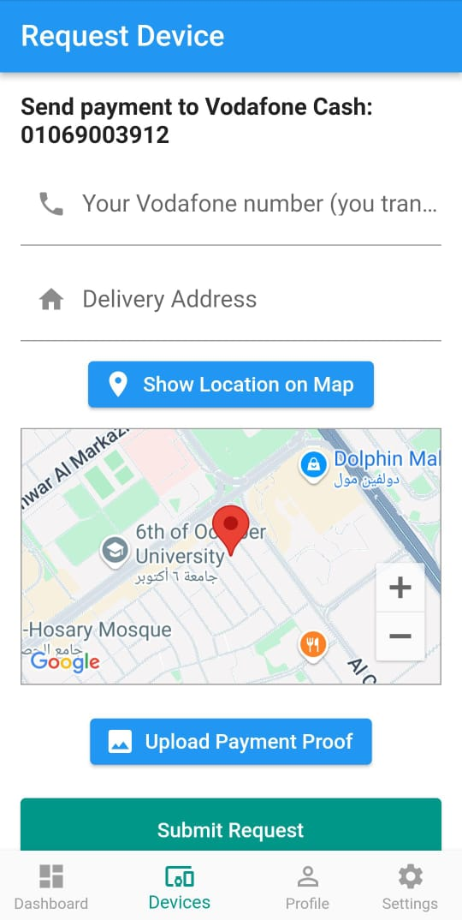
Request Device:
If the user doesn’t have a device, they can order one here.
They write their address, phone number, and upload payment proof.
They can also share their location.

Slide 31
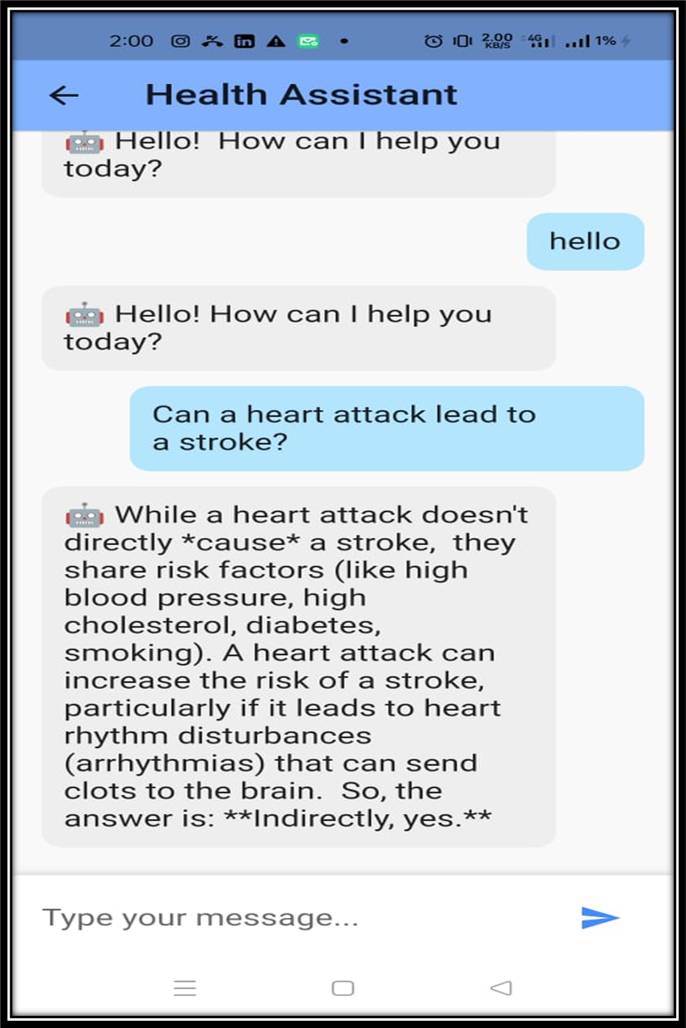
Chatbot Assistant:
This is the virtual assistant inside the app.
It helps the user by answering questions about their health.
It also gives useful tips and explains results in a simple way.

Slide 32
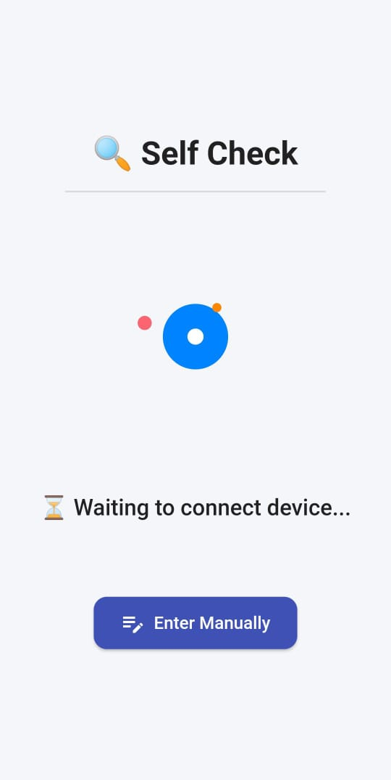
Self Check (with Device):
The app connects to a health device using Bluetooth.
It gets live data like heart rate, oxygen, and ECG.
This data helps the app check the stroke risk.

Slide 33
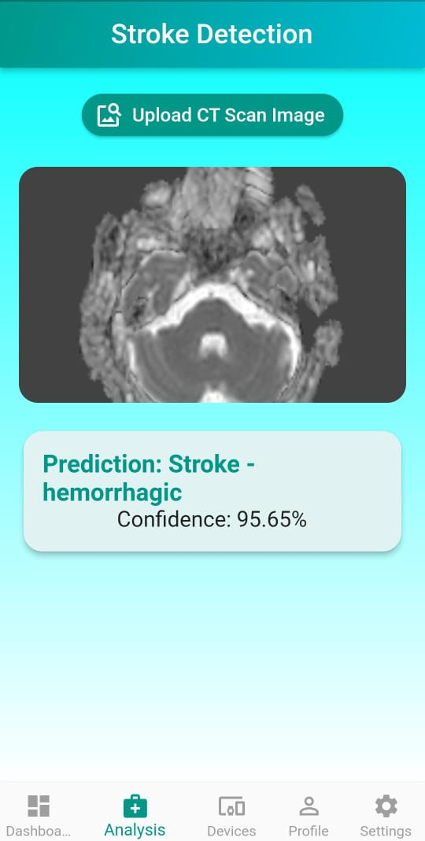
Stroke Detection from CT Image:
Upload CT scan of the brain
AI predicts stroke type (Eg : ischemic or hemorrhagic)
Returns confidence score (e.g. 95.65%)

Slide 34
How the App Works:
1.The app gets health data from the device and the users
2.Then it sends the data to an AI system.
3.The AI checks if the user is in danger of stroke.
4.It gives the result back to the app.

Slide 35

01
01
Introduction
Introduction and Workflow
02
Hardware Components
02
02
Hardware Components
Suggested Application
Mobile Application
03
Agenda
03
Mobile Application
04
Diagrams
04
AI Implementation
05
Future Work & Conclusion

Slide 36
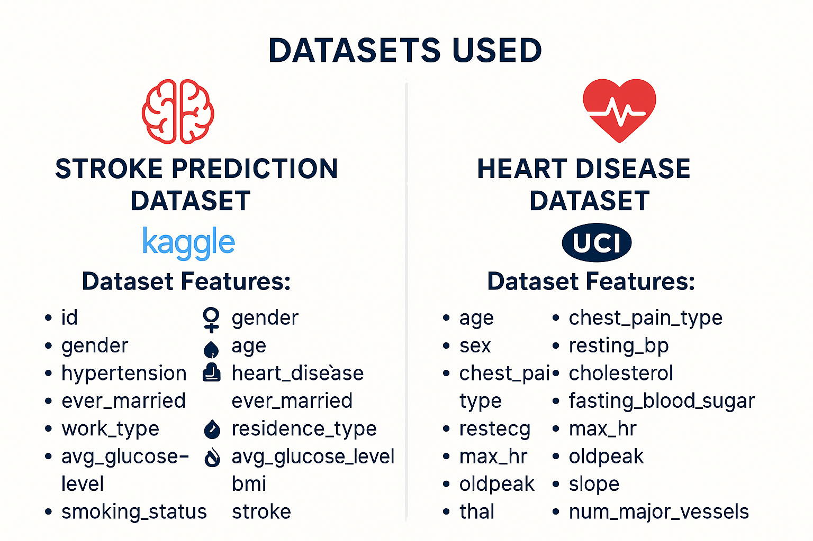

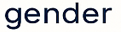

Slide 37
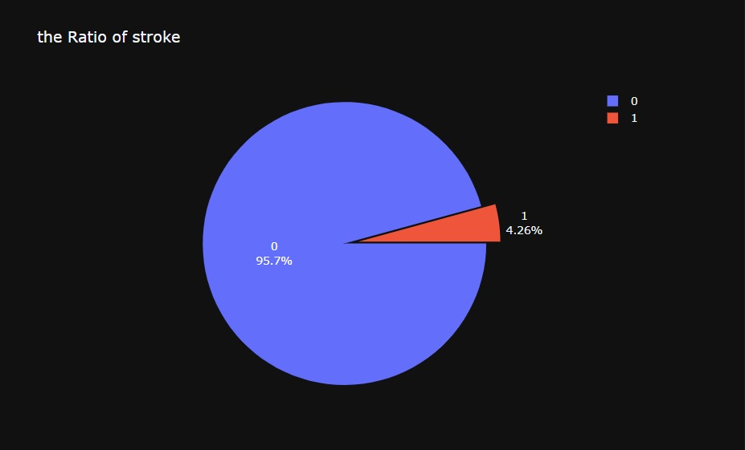
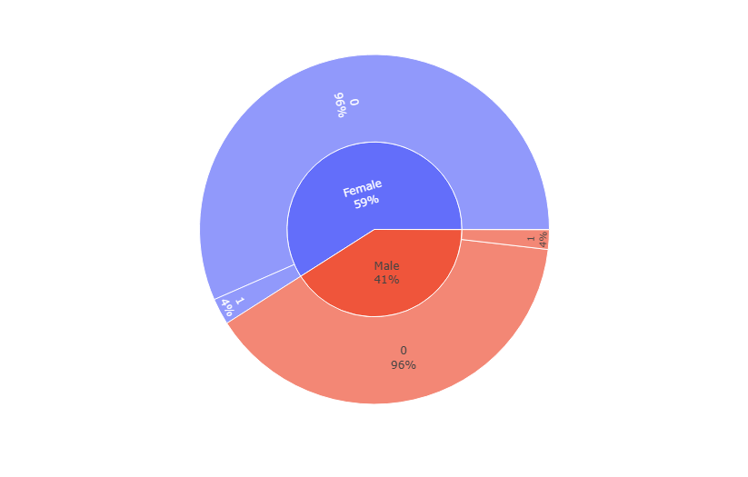
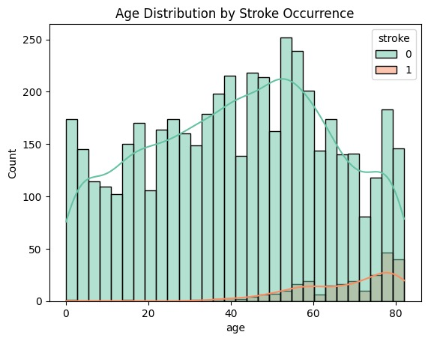
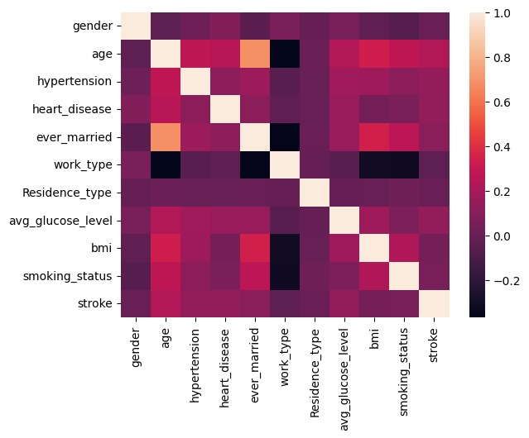
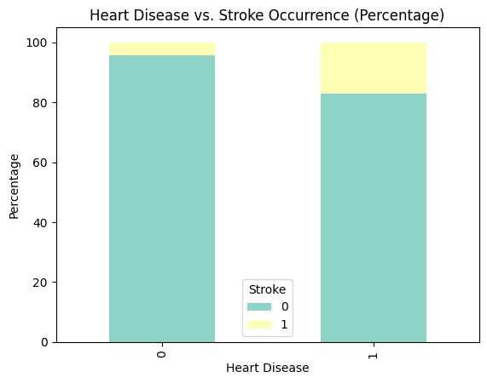
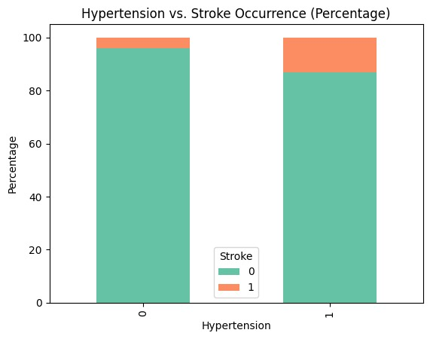
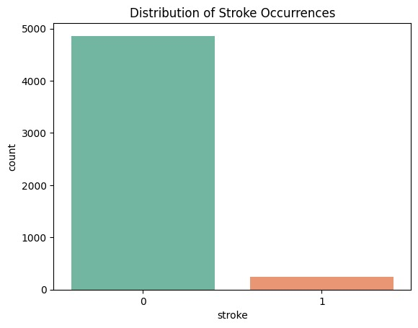
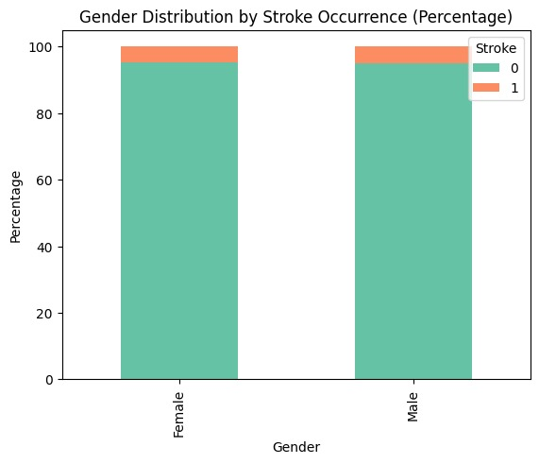
Exploratory Data Analysis
What is the relationship between hypertension and stroke?
How does heart disease relate to stroke occurrence?
What is the distribution of stroke occurrences?
Is there a gender difference in stroke occurrence?
How does age distribution differ between those who had a stroke and those who didn’t?
distribution of stroke
1
distribution Gender With Stroke
2
Age distribution With Stroke
3
Hypertension
4
Heart Disease
5
Heatmap Correlation
6

Slide 38
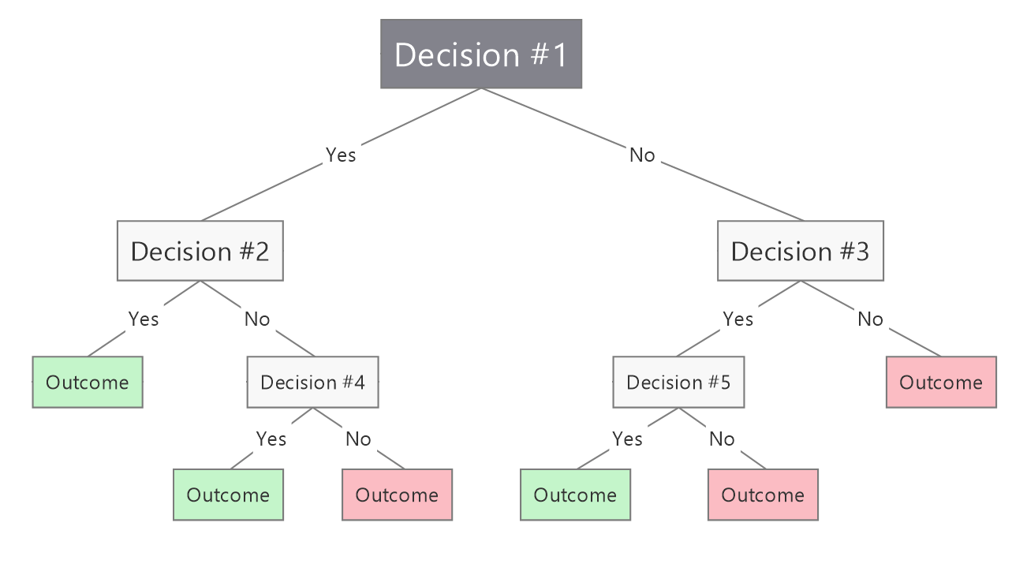
decision tree

Slide 39
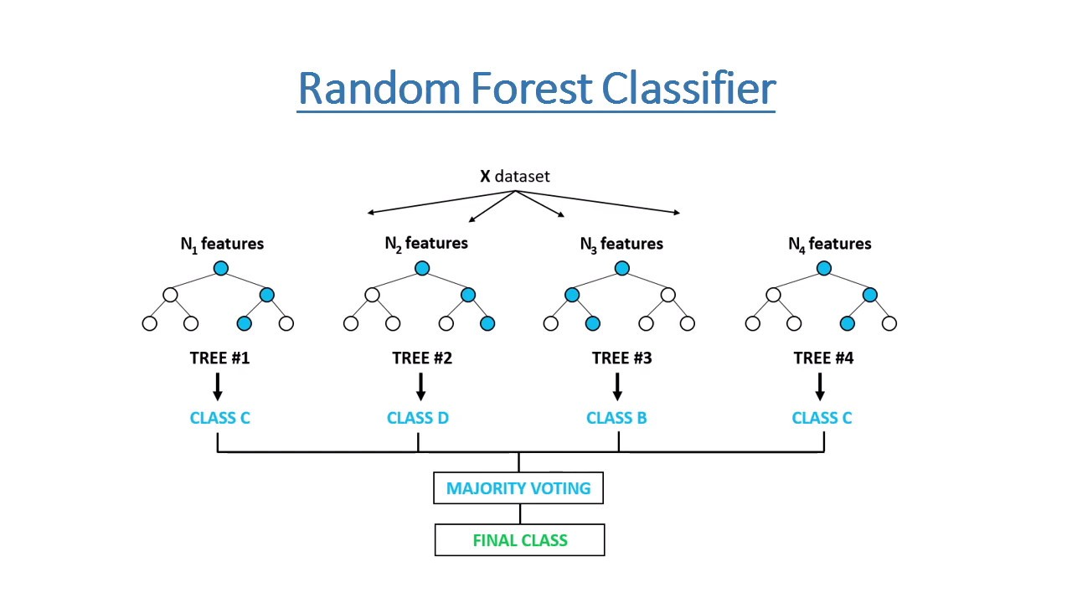

Slide 40
Model Architecture
exang
Max hr
restecg
Resting blood pressure
Work
Type
Ever
Married
Avg Glucose Level
oldpeak
Chest pain type
hypertension
BMI
slope
Sex
Gender
thal
Smoking Status
Heart Model
Age
Stroke Model
Stroke prediction
Heart disease

Slide 41
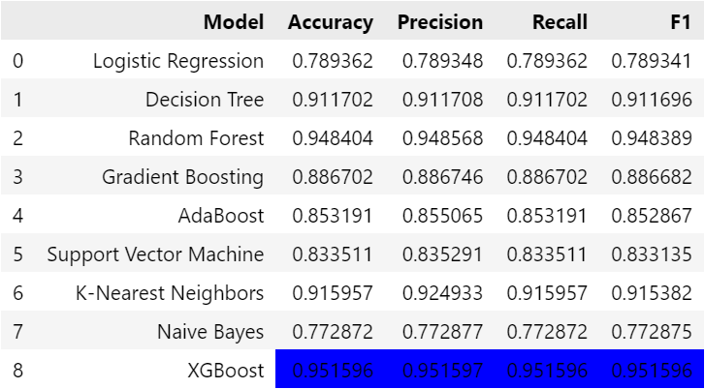
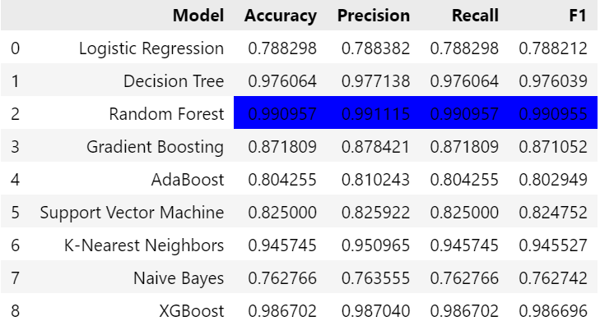
Solution to Deal with Imbalanced Data
Resampling data by SMOTE
Random Oversampling

Slide 42
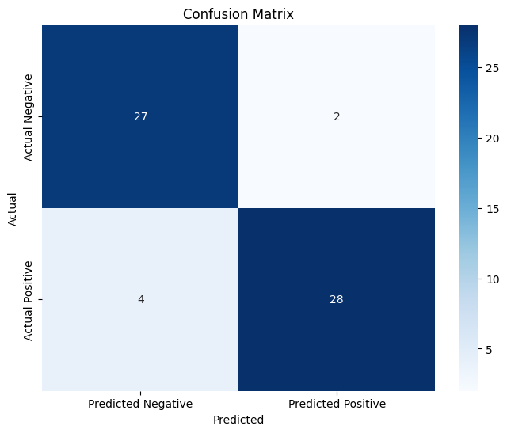

Results of Models
Heart disease Model
Stroke disease Model

Slide 43


Slide 44


Chatbot Fine-Tuning

Slide 45

Computer Vision Model

Slide 46


Slide 47


Results of Computer Vision Model
Main Model
Sub Model

Slide 48
01
01
Introduction
Introduction and Workflow
02
Hardware Components
02
02
Hardware Components
Suggested Application
Mobile Application
03
Agenda
03
Mobile Application
04
AI Implementation
05
Future Work & Conclusion

Slide 49
Future Work
Turn the prototype into a smart watch.
Improve the AI models with better data.
Add built-in blood pressure sensor.
Connect all sensors to Arduino.
Support more health conditions (e.g. diabetes).

Slide 50
Conclusion
We would like to express our sincere gratitude to:
Dr. Hossam El-Behairy, for his valuable guidance and continuous support.
Eng. Ahmed Abdelmonem, for his assistance, encouragement,
and feedback throughout the project.
Dr. Hossam Sakr, for his kind collaboration and helpful insights.
This project would not have been possible without your contribution

Slide 51


Slide 52
THANK YOU

Slide 53

Use case Diagram

Slide 54

Sequence Diagram

Slide 55

Data Flow Diagram (DFD ) Context Diagram

Slide 56

Data Flow Diagram (DFD) Level 0

Slide 57

Data Flow Diagram (DFD) Level 1

Slide 58

Data Flow Diagram (DFD) Level 2

Slide 59

ERD Diagram

Slide 60

Patient Activity Diagram

Slide 61

Admin Activity Diagram

